Slide 1
Chapter 18: Implementation Considerations

Slide 2
Key Takeaway Points
Everyone in the team should follow the same coding standards.
Test-driven development, pair programming, and code review improve the quality of the code.
Classes should be implemented according to their dependencies to reduce the need for test stubs.

Slide 3
Implementation in the Methodology Context
Business goals
& needs
Current situation
Use case-iteration allocation matrix
Accommodating
Requirements Change
Customer
feedback
Acquiring
Requirements
(Domain Modeling)
Iteration use cases
Domain Modeling
Preliminary requirements
Domain model
Domain model
Deriving Use Cases
from Requirements
Actor-System Interaction Modeling
Abstract & high level use cases, use case diagrams
Expanded use cases & UI design
Allocating Use Cases & Subsystems
to Iterations
Behavior Modeling &
Responsibility Assignment
Behavior models
Use case-iteration allocation matrix
Deriving Design Class
Diagram
Producing an Architecture Design
Design class diagram
Software architecture
Test Driven Development, Integration, & Deployment
(a) Planning Phase
(b) Iterative Phase – activities during each iteration
control flow
data flow
control flow & data flow

Slide 4
Coding Standards
Define the required and optional items.
Define the format and language.
Define the coding requirements and conventions.
Define the rules and responsibilities to create and implement the coding standards, as well as review and improve the practice.

Slide 5
Components of Coding Standards?
File header file location, version number, author, project, update history.
Description of classes – a functional description for each class including
  purpose
  description of methods
  description of fields
  in-code comments
Conventions

Slide 6
Coding Conventions
Naming conventions specify rules for naming packages, modules, paths, files, classes, attributes, functions, constants, and the like.
Formatting conventions specify formatting rules for line breaking, indentation, alignment, and spacing.
In-code comment conventions define the requirements and guidelines for writing in-code documentation.

Slide 7
Guidelines for Practicing Coding Standards
Define barely enough coding standards.
The coding standards should be easy to understand and practice.
The coding standards should be documented and include examples.
Training on how to use the coding standards is helpful.

Slide 8
Guidelines for Practicing Coding Standards
The coding standards, once defined and published, should be practiced, enforced, and checked for compliance regularly.
It is important to assign the responsibilities to individuals and make sure that all involved know the assignment.
The practice of coding standards should involve stakeholders.

Slide 9
Organizing the Implementation Artifacts
Architectural-style organization: Classes are organized according to an architectural style.
Functional subsystem organization: Classes are organized according to the functional subsystems of the software system.
Hybrid organizations:
  architectural-style functional subsystem organization
  functional subsystem architectural-style organization

Slide 10
N-Tier Architecture
:Use Case Controller
:Use Case GUI
:Business Object
:DB Mgr
:Net Mgr
(a) Sequence diagram showing layers of a system
Database Connectivity
GUI
Controller
Business Objects
Network
(b) Corresponding N-Tier architecture

Slide 11
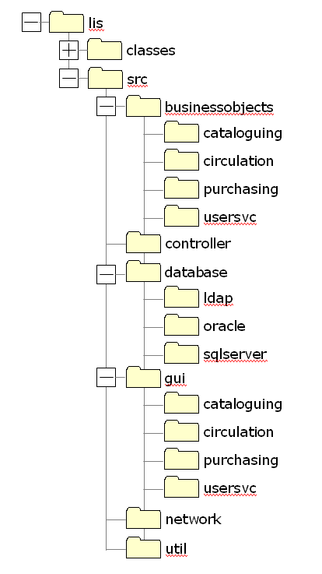
Corresponding Directory Structure

Slide 12
Implementation
Assign classes to team members according to
  dependencies between classes, and
  abilities of the team members
  to reduce number of test stubs
Implement classes

Slide 13
Applying Agile Principles
Develop small, incremental releases and iterate; focus on frequent delivery of software products.
Complete each feature before moving onto the next.
Test early and often.
Everybody owns the code—everybody is responsible for the quality of the code.

